Slide 1

A Better Public Involvement Approach
W2Pi
Web Platform for Public
Involvement
By MSc Fernando Santos
fss1g15@soton.ac.uk

Slide 2
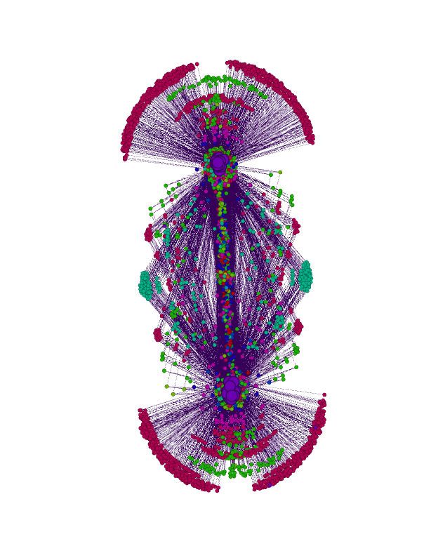
What we want to do?
To employ text analytics and the Web to enhance the public feedback on Patient Information Resources
Use a Web platform to capture, store and deliver public feedback
Use sentiment analysis to identify highly-negative sections
Use content analysis to objectively assess reading difficulty
Use public reviewers to assess the information quality

Slide 3

Why we want to do it?
Current Patient Information resources are lacking quality, funding organizations consider it important
Public involvement may be requested before funds are given
–NHS National Institute for Health Research [1]
Interactive questioning of potential participants can highlight areas that are misunderstood
–Medical Research Council (MRC) [2]
Recommended payment £25 per hour per person for public reviewers
–INVOLVE [3]

Slide 4
Top 10 Prioritised Research Questions
Health Research Board Trails Methodology Network & James Lind Alliance Final Report 2018 [4]
Overall Ranking | Research Question
1 | How can randomised trials become part of routine care?
2 | What information should be communicated to members of the public who are being invited into a randomised trial?
3 | Does patient/public involvement in planning a randomised trial improves recruitment?
4 | What are the best approaches for designing and delivering information to the public?
5 | What are the barriers and enablers for clinical researchers in conducting clinical trials?
6 | What are the key motivators influencing members of the public’s decisions to take part?
7 | What are the best approaches to ensure inclusion and participation of under represented / vulnerable groups in randomised trials?
8 | What are the best ways to predict recruitment rates to trials?
9 | What are the best approaches to optimise the informed consent process?
10 | What are the advantages and disavantages to using technology during recruitment?

Slide 5
Top 10 Prioritised Research Questions
Health Research Board Trails Methodology Network & James Lind Alliance Final Report 2018 [4]
Overall Ranking | Research Question
1 | How can randomised trials become part of routine care?
2 | What information should be communicated to members of the public who are being invited into a randomised trial?
3 | Does patient/public involvement in planning a randomised trial improves recruitment?
4 | What are the best approaches for designing and delivering information to the public?
5 | What are the barriers and enablers for clinical researchers in conducting clinical trials?
6 | What are the key motivators influencing members of the public’s decisions to take part?
7 | What are the best approaches to ensure inclusion and participation of under represented / vulnerable groups in randomised trials?
8 | What are the best ways to predict recruitment rates to trials?
9 | What are the best approaches to optimise the informed consent process?
10 | What are the advantages and disadvantages to using technology during recruitment?

Slide 6
Our proposal
Traditional Public Feedback Model
High-Quality Assurance Process
Information Quality
Jargon finding
Comment analysis
Phrase analysis
Public quality evaluation
Online feedback process
Previous knowledge

Slide 7
Necessary steps to clinical research
Research question
Research current situation
What can be affecting the quality?
Offer a solution
What is different?
Can Web techniques help?

Slide 8
References
“Patient and public involvement in health and social care research: A handbook for researchers”, NHS National Institute for Health Research (NIHR), 2010.
“Principles of consent: General principles and role of Participant Information Sheets”, Medical Research Council (MRC), accessed 2017, [http://www.hra-decisiontools.org.uk/consent/principles-general.html]
“Budgeting for involvement: Practical advice on budgeting for actively involving the public in research studies” p.12, INVOLVE and NHS NIHR, 2013.
“Prioritising recruitment in randomised trials: the priority study-an Ireland and UK priority setting partnership”, Health Research Board Trials Methodology Research Network and James Lind Alliance, 2017.

Slide 9

W2Pi
A Web Platform for Public Involvement
By Fernando Santos Sanchez,
MSc in Web Science
fss1g15@soton.ac.uk

